Slide 1

Automated WebAssembly Function Purpose Identification With Semantics-Aware Analysis
Alan Romano and Weihang Wang

Slide 2

What is WebAssembly?
A new language for the web
Enables high-performance computations
Compiled binary format for efficient network transmission
Compilation target for C, C++, Rust, etc…

Slide 3
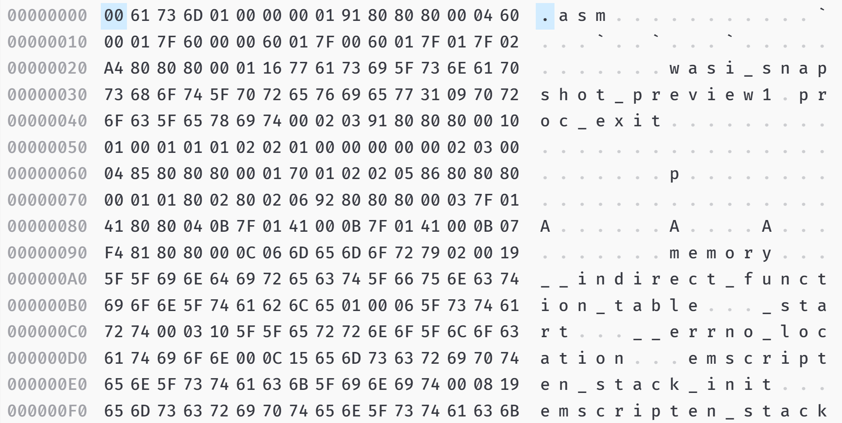
C++
WebAssembly Binary
WebAssembly Text
int main(){
int b = 9;
int a = 9;
if(a == b){
return 1;
} else {
return 0;
}
}
(module
(func main(result i32)
(local i32 i32 i32 i32 )
global.get 0
local.set 0
i32.const 16
local.set 1
local.get 0
local.get 1
i32.sub
local.set 2
i32.const 0
local.set 3
local.get 2
local.get 3
i32.store offset=12
i32.const 9
local.set 4
local.get 2
.
.
.

Slide 4
Motivation
(module
(func main(result i32)
(local i32 i32 i32 i32 )
global.get 0
local.set 0
i32.const 16
local.set 1
local.get 0
local.get 1
i32.sub
local.set 2
i32.const 0
local.set 3
local.get 2
local.get 3
i32.store offset=12
i32.const 9
local.set 4
local.get 2
local.get 4
i32.store offset=8
i32.const 9
local.set 5
local.get 2
local.get 5
i32.store offset=4
local.get 2
i32.load offset=4
local.set 6
local.get 2
i32.load offset=8
local.set 7
local.get 6
local.set 8
local.get 7
local.set 9
local.get 8
local.get 9
i32.eq
WebAssembly syntax is difficult to understand
Low level assembly-like instructions
Limited data types
Stack machine architecture
WebAssembly modules are frequently distributed by third-parties

Slide 5



Our Work
WebAssembly
Binary
WASPur: An automated WebAssembly function purpose identification tool
Propose semantics-aware analysis of WebAssembly instruction
Construct dataset of diverse WebAssembly modules
Comprehensive analysis of collected modules
Train and evaluate classifier to label functions with an accuracy of 88.07%
Collected
Samples
Abstraction
Generator
$func:
Abstraction Sequence w/ Function Name
New Abstraction
Sequence w/o Name
Training
Samples
$func:
Classifier
$some:
$name:
Predicted Function Name

Slide 6
Semantics-Aware Intermediate Representation
Intermediate representation (IR) on WebAssembly instructions
Captures high-level semantics of instructions by modeling effects on:
Control flow
Local and global variables
Linear memory
Abstracts away low-level syntax details
WebAssembly
Binary
Collected
Samples
Abstraction
Generator
$func:
Abstraction Sequence w/ Function Name
New Abstraction
Sequence w/o Name
Training
Samples
$func:
Classifier
$some:
$name:
Predicted
Function
Name

Slide 7
List of Abstraction Rules
Stack
WebAssembly Instruction Groups
Def Set
Abstraction
Numeric Instructions
E.g., i32.const, i64.add
Parametric Instructions
I.e., drop, select
(Effect on Stack)
(Effect on Stack)

Slide 8
List of Abstraction Rules
Stack
WebAssembly Instruction Groups
Def Set
Abstraction
Variable Instructions
Store Instructions
E.g., local.set
Load Instructions
I.e., local.get
Memory Instructions
Store Access Instructions
E.g., f64.store
Load Access Instructions
E.g., i32.load
(Effect on Stack)
Update Def(Dst) with new Value
SET: Dst; Value; Type;
(Effect on Stack)
(Effect on Stack)
Update Def([Dst]) with new Value
STORE: Src; Dst; Type;
(Effect on Stack)

Slide 9
List of Abstraction Rules
Stack
WebAssembly Instruction Groups
Def Set
Abstraction
Control Instructions
Call Instructions
I.e., call_indirect
Block Instructions
E.g., block, br
Loop Instructions
I.e., loop
Conditional Instructions
E.g., if else, br_if
(Effect on Stack)
CALL: Target;
BLOCK: InnerAbstractions;
(Effect on Stack)
FOR: InnerAbstractions; Condition;
(Effect on Stack)
IF: Condition; IfAbstractions; ElseAbstractions;
(Effect on Stack)

Slide 10
WebAssembly Module Dataset Collection
Source | Scanned Dates | # of Samples | # of Samples Using Wasm | # of Wasm
Alexa Top 1 Million Websites | Oct 2018 - May 2020 | 1,000,000 | 3,154 | 4,520
Chrome Extensions | Mar 25 - 30, 2019 | 17,862 | 55 | 90
Firefox Add-ons | Jul 30, 2019 | 16,385 | 30 | 43
GitHub Repositories | Oct 3, 2019 | 112,663,634 | 435 | 2,116
# of Wasm in Total |  |  | 3,397 | 6,769 w/ 1,829 Unique

Slide 11
WebAssembly Module Use Cases
Compression - Performs data compression operations
Cryptography - Performs cryptographic operations (e.g., hashing)
Game - Implements stand-alone online games
Text Processing - Performs text or word processing
Image Processing - Analyzes or edits images
Numeric Processing - Provides commonly used mathematical or numeric functions
Support Test Stub - Probes environment for WebAssembly support
Standalone Apps - Independent standalone programs
Auxiliar Library - Provides commonly used data structures or utility functions
Cryptominer - Performs cryptocurrency-mining operations
Code Carrier - Stores JavaScript/CSS/HTML payloads
Unit Test - Ensures conformance to language specification

Slide 12
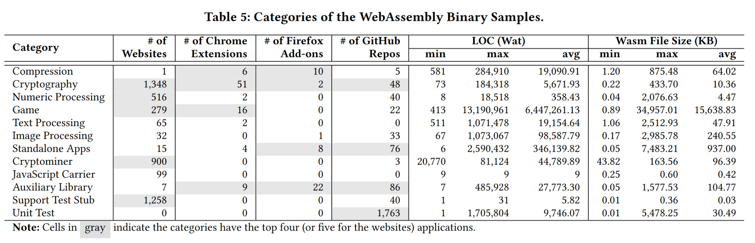
Dataset Description (cont.)

Slide 13
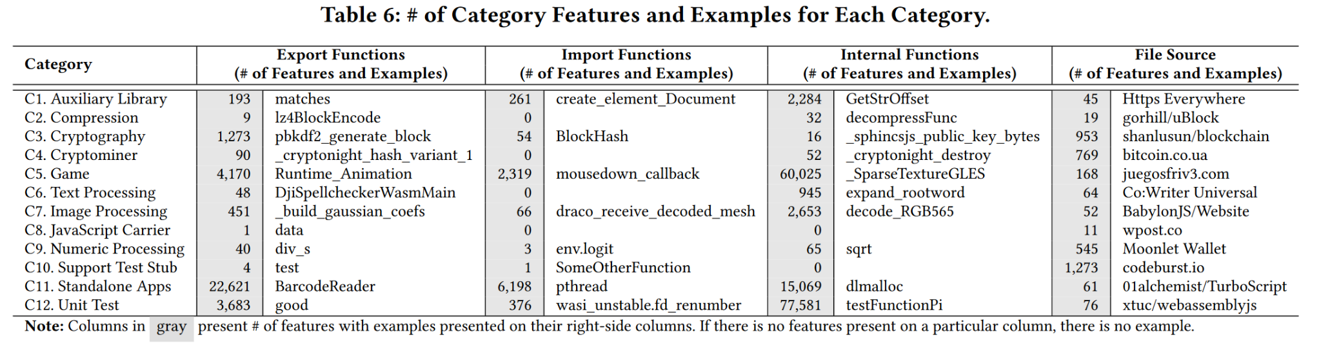
Dataset Description (cont.)

Slide 14
WebAssembly Function Dataset Collection
From 1,829 unique modules, we extract 11,524,686 functions in total
Of these, 151,662 functions have their original names
We create 189 categories on the names of these functions
E.g., malloc, atoi, add, dynCall

Slide 15
Classification
Build a neural network classifier with IR sequence trace as input
Output the labels of functions that are most similar to identified functions
WebAssembly
Binary
Collected
Samples
Abstraction
Generator
$func:
Abstraction Sequence w/ Function Name
New Abstraction
Sequence w/o Name
Training
Samples
$func:
Classifier
$some:
$name:
Predicted
Function
Name

Slide 16
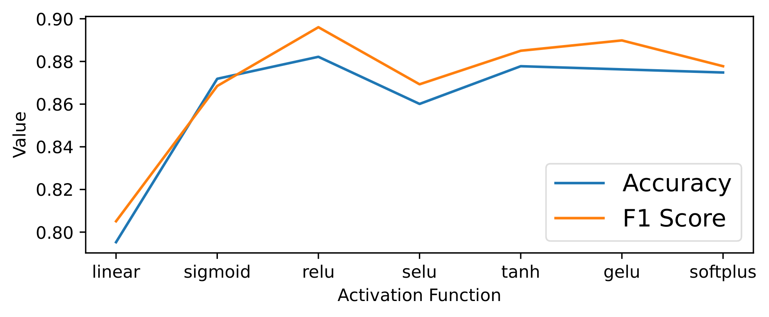
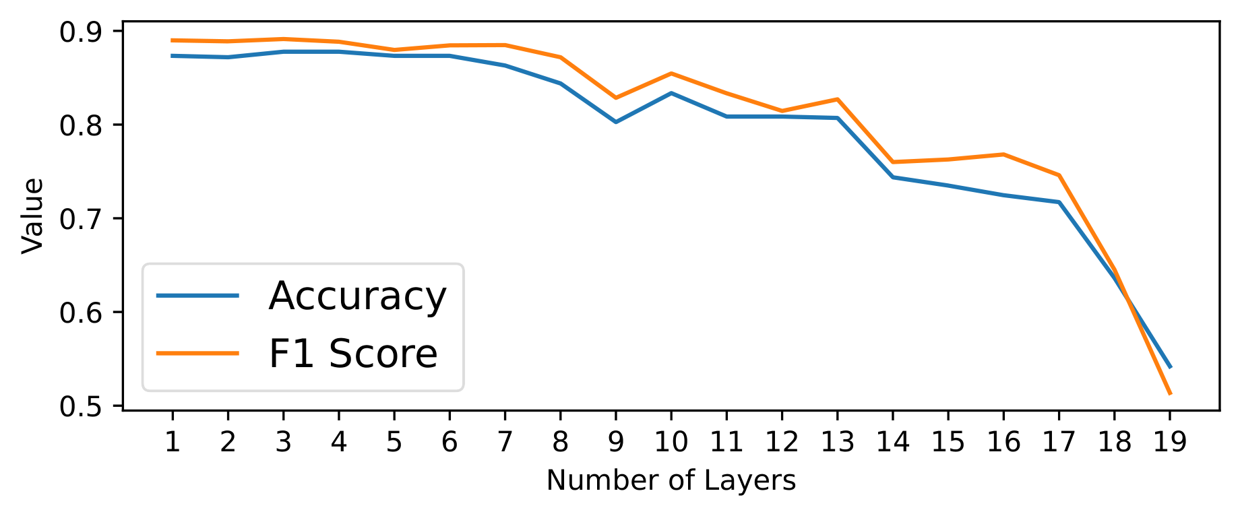
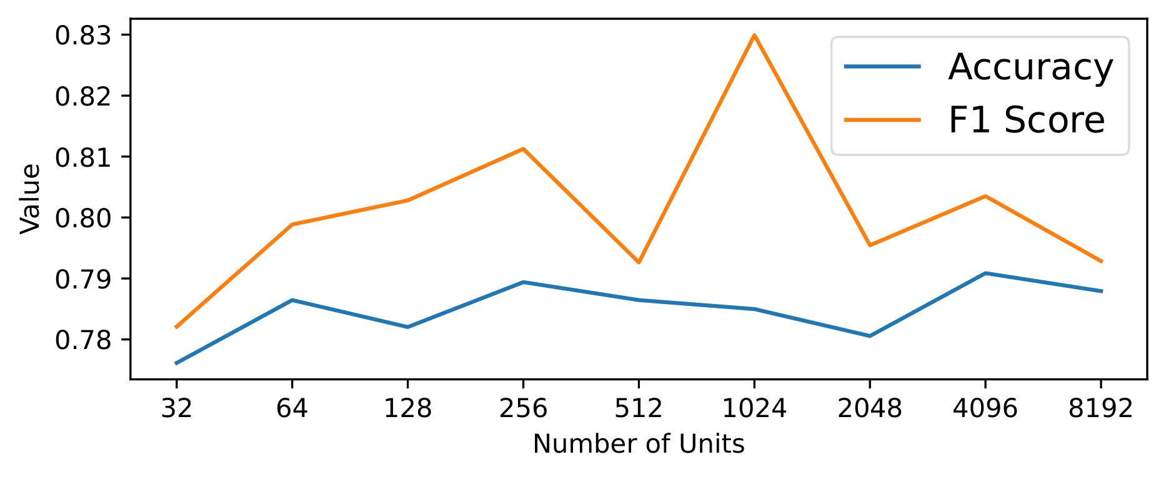
Neural Network Configurations
Activation Functions
Number of Layers
Number of Hidden Units

Slide 17
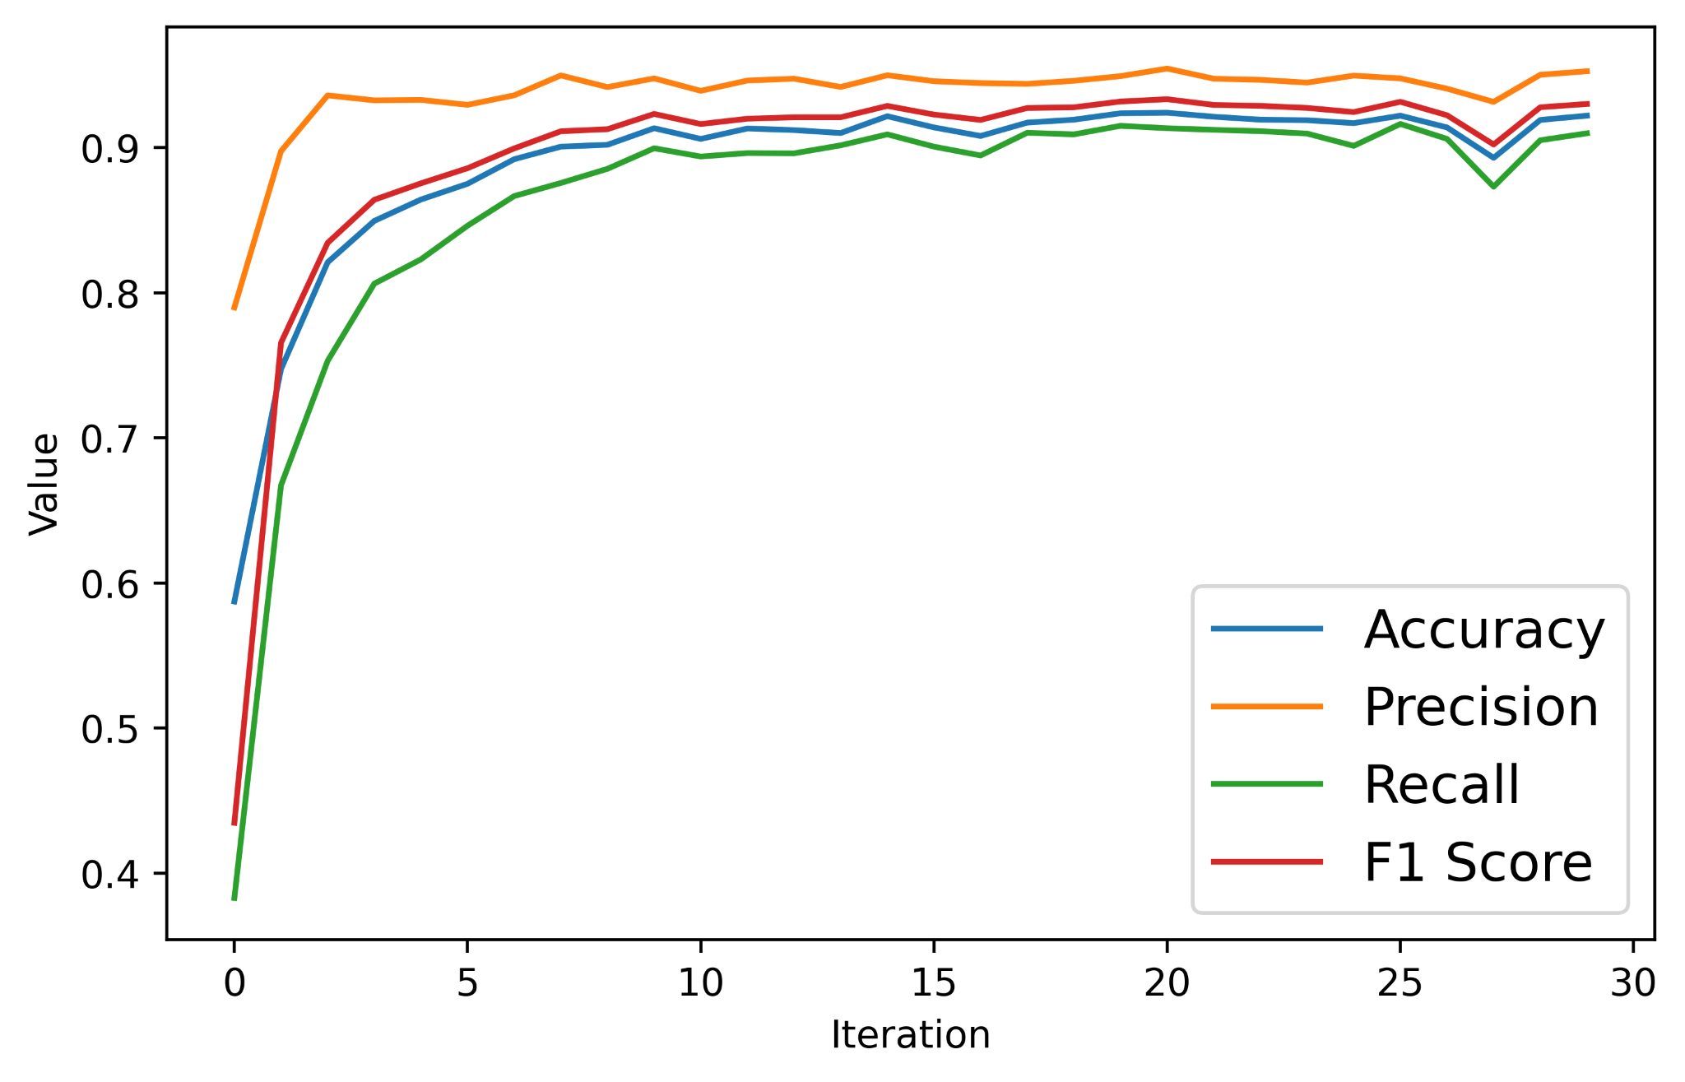
Best-Performing Configuration
3 fully-connected layers
1,024 hidden units per layer
ReLU activation function
Classification Results:
Accuracy: 88.07%
Precision: 0.92
Recall: 0.87
F1 Score: 0.91

Slide 18
Future Work
Analyze modules beyond Functions section
Other information in Types, Imports, and Data sections could provide greater context when determining the purposes of contained functions
Leverage symbolic values in classification
Include symbolic expressions representing intermediate computations
Provide a greater context for determining the labels

Slide 19
Related Work
WebAssembly Prevalence Studies [1-2]
WebAssembly-Based Cryptominer Studies [3-7]
WebAssembly Analysis Tools [8-12]
Natural Language Processing and Machine Learning on Binary Code [13-39]

Slide 20
References
Marius Musch, Christian Wressnegger, Martin Johns, and Konrad Rieck. 2019. New Kid on the Web: A Study on the Prevalence of WebAssembly in the Wild. In International Conference on Detection of Intrusions and Malware, and Vulnerability. Springer, 23–42.
Aaron Hilbig, Daniel Lehmann, and Michael Pradel. 2021. An Empirical Study of Real-World WebAssembly Binaries: Security, Languages, Use Cases. In Proceedings of the Web Conference 2021 (Ljubljana, Slovenia) (WWW ’21). Association for Computing Machinery, New York, NY, USA, 2696–2708. https://doi.org/10.1145/3442381.3450138
Radhesh Krishnan Konoth, Emanuele Vineti, Veelasha Moonsamy, Martina Lindorfer, Christopher Kruegel, Herbert Bos, and Giovanni Vigna. 2018. MineSweeper: An In-depth Look into Drive-by Cryptocurrency Mining and Its Defense. In Proceedings of the 2018 ACM SIGSAC Conference on Computer and Communications Security (Toronto, Canada) (CCS ’18). ACM, New York, NY, USA, 1714–1730. https://doi.org/10.1145/3243734.3243858
Amin Kharraz, Zane Ma, Paul Murley, Charles Lever, Joshua Mason, Andrew Miller, Nikita Borisov, Manos Antonakakis, and Michael Bailey. 2019. Outguard: Detecting In-Browser Covert Cryptocurrency Mining in the Wild. In The World Wide Web Conference (San Francisco, CA, USA) (WWW ’19). ACM, New York, NY, USA, 840–852. https://doi.org/10.1145/3308558.3313665
Marius Musch, Christian Wressnegger, Martin Johns, and Konrad Rieck. 2018. Web-based Cryptojacking in the Wild. CoRR abs/1808.09474 (2018). arXiv:1808.09474 http://arxiv.org/abs/1808.09474
Marius Musch, Christian Wressnegger, Martin Johns, and Konrad Rieck. 2019. Thieves in the Browser: Web-based Cryptojacking in the Wild. In Proceedings of the 14th International Conference on Availability, Reliability and Security (Canterbury, CA, United Kingdom) (ARES ’19). ACM, New York, NY, USA, Article 4, 10 pages. https://doi.org/10.1145/3339252.3339261
Alan Romano, Yunhui Zheng, and Weihang Wang. 2020. MinerRay: Semantics-Aware Analysis for Ever-Evolving Cryptojacking Detection. Proceedings of the 35th ACM/IEEE International Conference on Automated Software Engineering (2020).
H. Jeong, J. Jeong, S. Park, and K. Kim. 2018. WATT : A novel web-based toolkit to generate WebAssembly-based libraries and applications. In 2018 IEEE International Conference on Consumer Electronics (ICCE). 1–2. https://doi.org/10.1109/ICCE.2018.8326230
William Fu, Raymond Lin, and Daniel Inge. 2018. TaintAssembly: Taint-Based Information Flow Control Tracking for WebAssembly. CoRR abs/1802.01050 (2018). arXiv:1802.01050 http://arxiv.org/abs/1802.01050
Aron Szanto, Timothy Tamm, and Artidoro Pagnoni. 2018. Taint Tracking for WebAssembly. CoRR abs/1807.08349 (2018). arXiv:1807.08349 http://arxiv.org/abs/1807.08349

Slide 21
References (cont.)
Daniel Lehmann and Michael Pradel. 2019. Wasabi: A Framework for Dynamically Analyzing WebAssembly. In Proceedings of the Twenty-Fourth International Conference on Architectural Support for Programming Languages and Operating Systems (ASPLOS '19). Association for Computing Machinery, New York, NY, USA, 1045–1058. https://doi.org/10.1145/3297858.3304068
Alan Romano and Weihang Wang. 2020. WASim: Understanding WebAssembly Applications through Classification. In Proceedings of the 35th IEEE/ACM International Conference on Automated Software Engineering (Virtual Event, Australia) (ASE ’20). Association for Computing Machinery, New York, NY, USA, 1321–1325. https://doi.org/10.1145/3324884.3415293
J. Escobar-Avila, M. Linares-Vásquez, and S. Haiduc. 2015. Unsupervised Software Categorization Using Bytecode. In 2015 IEEE 23rd International Conference on Program Comprehension. 229–239. https://doi.org/10.1109/ICPC.2015.33
Alexander LeClair, Zachary Eberhart, and Collin McMillan. 2018. Adapting Neural Text Classification for Improved Software Categorization. CoRR abs/1806.01742 (2018). arXiv:1806.01742 http://arxiv.org/abs/1806.01742
S. Haiduc, J. Aponte, L. Moreno, and A. Marcus. 2010. On the Use of Automated Text Summarization Techniques for Summarizing Source Code. In 2010 17th Working Conference on Reverse Engineering. 35–44. https://doi.org/10.1109/WCRE.2010.13
Alexander LeClair, Siyuan Jiang, and Collin McMillan. 2019. A Neural Model for Generating Natural Language Summaries of Program Subroutines. CoRR abs/1902.01954 (2019). arXiv:1902.01954 http://arxiv.org/abs/1902.01954
Vincent J. Hellendoorn and Premkumar Devanbu. 2017. Are Deep Neural Networks the Best Choice for Modeling Source Code?. In Proceedings of the 2017 11th Joint Meeting on Foundations of Software Engineering (Paderborn, Germany) (ESEC/FSE 2017). ACM, New York, NY, USA, 763–773. https://doi.org/10.1145/3106237.3106290
Alwin Maier, Hugo Gascon, Christian Wressnegger, and Konrad Rieck. 2019. TypeMiner: Recovering Types in Binary Programs Using Machine Learning. In Detection of Intrusions and Malware, and Vulnerability Assessment (Lecture Notes in Computer Science), Roberto Perdisci, Clémentine Maurice, Giorgio Giacinto, and Magnus Almgren (Eds.). Springer International Publishing, Cham, 288–308. https://doi.org/10.1007/978-3-030-22038-9_14
Luca Massarelli, Giuseppe A. Di Luna, Fabio Petroni, Leonardo Querzoni, and Roberto Baldoni. 2019. Investigating Graph Embedding Neural Networks with Unsupervised Features Extraction for Binary Analysis. https://doi.org/10.14722/Bar.2019.23020
D. Di Nucci, F. Palomba, D. A. Tamburri, A. Serebrenik, and A. De Lucia. 2018. Detecting code smells using machine learning techniques: Are we there yet?. In 2018 IEEE 25th International Conference on Software Analysis, Evolution and Reengineering (SANER). IEEE Computer Society, Los Alamitos, CA, USA, 612–621. https://doi.org/10.1109/SANER.2018.8330266

Slide 22
References (cont.)
Nathan E. Rosenblum, Xiaojin Zhu, B. Miller, and Karen Hunt. 2007. Machine Learning-Assisted Binary Code Analysis.
Shuai Wang and Dinghao Wu. 2017. In-Memory Fuzzing for Binary Code Similarity Analysis. In 2017 32nd IEEE/ACM International Conference on Automated Software Engineering (ASE). 319–330. https://doi.org/10.1109/ASE.2017.8115645
Mario Linares-Vásquez, Collin McMillan, Denys Poshyvanyk, and Mark Grechanik. 2014. On using machine learning to automatically classify software applications into domain categories. Empirical Software Engineering 19, 3 (01 Jun 2014), 582–618. https://doi.org/10.1007/s10664-012-9230-z
Matthieu Jimenez, Renaud Rwemalika, Mike Papadakis, Federica Sarro, Yves Le Traon, and Mark Harman. 2019. The Importance of Accounting for Real-world Labelling when Predicting Software Vulnerabilities. In Proceedings of the 2019 27th ACM Joint Meeting on European Software Engineering Conference and Symposium on the Foundations of Software Engineering (Tallinn, Estonia) (ESEC/FSE 2019). ACM, New York, NY, USA, 695–705. https://doi.org/10.1145/3338906.3338941
Kevin Allix, Tegawendé Bissyandé, Quentin Jérome, Jacques Klein, Radu State, and Yves Le Traon. 2014. Empirical assessment of machine learning-based malware detectors for Android. Empirical Software Engineering 21 (12 2014), 1–29. https://doi.org/10.1007/s10664-014-9352-6
M. A. Atici, S. Sagiroglu, and I. A. Dogru. 2016. Android malware analysis approach based on control flow graphs and machine learning algorithms. In 2016 4th International Symposium on Digital Forensic and Security (ISDFS). 26–31. https://doi.org/10.1109/ISDFS.2016.7473512
Hugo Gascon, Fabian Yamaguchi, Daniel Arp, and Konrad Rieck. 2013. Structural Detection of Android Malware Using Embedded Call Graphs. In Proceedings of the 2013 ACM Workshop on Artificial Intelligence and Security (Berlin, Germany) (AISec ’13). ACM, New York, NY, USA, 45–54. https://doi.org/10.1145/2517312.2517315
J. Sahs and L. Khan. 2012. A Machine Learning Approach to Android Malware Detection. In 2012 European Intelligence and Security Informatics Conference. 141– 147. https://doi.org/10.1109/EISIC.2012.34
M.G. Schultz, E. Eskin, F. Zadok, and S.J. Stolfo. 2001. Data Mining Methods for Detection of New Malicious Executables. In Proceedings 2001 IEEE Symposium on Security and Privacy. S&P 2001. 38–49. https://doi.org/10.1109/SECPRI.2001.924286
C. S. Corley, K. Damevski, and N. A. Kraft. 2015. Exploring the use of deep learning for feature location. In 2015 IEEE International Conference on Software Maintenance and Evolution (ICSME). 556–560. https://doi.org/10.1109/ICSM.2015.7332513

Slide 23
References (cont.)
Ali Mesbah, Andrew Rice, Emily Johnston, Nick Glorioso, and Edward Aftandilian. 2019. DeepDelta: Learning to Repair Compilation Errors. In Proceedings of the 2019 27th ACM Joint Meeting on European Software Engineering Conference and Symposium on the Foundations of Software Engineering (Tallinn, Estonia) (ESEC/FSE 2019).
Tianchi Zhou, Xiaobing Sun, Xin Xia, Bin Li, and Xiang Chen. 2019. Improving defect prediction with deep forest. Information and Software Technology 114 (2019), 204 – 216. https://doi.org/10.1016/j.infsof.2019.07.003
Martin White, Christopher Vendome, Mario Linares-Vásquez, and Denys Poshyvanyk. 2015. Toward Deep Learning Software Repositories. In Proceedings of the 12th Working Conference on Mining Software Repositories (Florence, Italy) (MSR ’15). IEEE Press, Piscataway, NJ, USA, 334–345. http://dl.acm.org/citation.cfm?id=2820518.2820559
Fang-Hsiang Su, Jonathan Bell, Gail Kaiser, and Baishakhi Ray. 2018. Obfuscation Resilient Search Through Executable Classification. In Proceedings of the 2Nd ACM SIGPLAN International Workshop on Machine Learning and Programming Languages (Philadelphia, PA, USA) (MAPL 2018). ACM, New York, NY, USA, 20–30. https://doi.org/10.1145/3211346.3211352
M. Santacroce, Daniel Koranek, David Kapp, Anca Ralescu, and R. Jha. 2018. Detecting Malicious Assembly with Deep Learning. In NAECON 2018 - IEEE National Aerospace and Electronics Conference. 82–85. https://doi.org/10.1109/ NAECON.2018.8556657
Joshua Saxe and Konstantin Berlin. 2015. Deep Neural Network Based Malware Detection Using Two Dimensional Binary Program Features. In 2015 10th International Conference on Malicious and Unwanted Software (MALWARE). 11–20. https://doi.org/10.1109/MALWARE.2015.7413680
Bingchang Liu, Wei Huo, Chao Zhang, Wenchao Li, Feng Li, Aihua Piao, and Wei Zou. 2018. 𝛼Diff: Cross-Version Binary Code Similarity Detection with DNN. In Proceedings of the 33rd ACM/IEEE International Conference on Automated Software Engineering (ASE ’18). Association for Computing Machinery, New York, NY, USA, 667–678. https://doi.org/10.1145/3238147.3238199
Donghai Tian, Xiaoqi Jia, Rui Ma, Shuke Liu, Wenjing Liu, and Changzhen Hu. 2021. BinDeep: A Deep Learning Approach to Binary Code Similarity Detection. Expert Systems with Applications 168 (April 2021), 114348. https://doi.org/10.1016/j.eswa.2020.114348
Shouguo Yang, Long Cheng, Yicheng Zeng, Zhe Lang, Hongsong Zhu, and Zhiqiang Shi. 2021. Asteria: Deep Learning-based AST-Encoding for Cross-platform Binary Code Similarity Detection. In 2021 51st Annual IEEE/IFIP International Conference on Dependable Systems and Networks (DSN). 224–236. https://doi.org/10.1109/DSN48987.2021.00036

Slide 24
Conclusion
Develop WASpur, a tool that can label a function with an 88.07% accuracy rate
Propose an intermediate representation to abstract underlying semantics
Construct a dataset of diverse WebAssembly samples from four different sources
Perform a comprehensive analysis of our collected WebAssembly samples
Thank You!
Alan Romano
ajromano@usc.edu
Weihang Wang
weihangw@usc.edu

